Slide 1
NLP Surname Classification with MLP lecture 03.3
Branko Žitko

Slide 2
Contents
Vocabulary, Vectorizer
Dataset
DataLoader
A Multilayer Perceptron Classifier
The Training Routine
Evaluation, Inference, Inspection
Regularizing MLPs

Slide 3
Vocabulary
Vocabulary maps token to index and vice versa
It can also use fixed index for unknown tokens.
SurnameVocab
NationalityVocab
the →
token | idx
-1 | <unk>
0 | unfortunately
1 | the
2 | frustration
…
n
→ 1
token | idx
0 | 1
1 | 2
2 →
→ frustration

Slide 4
Vocabulary
Vocabulary
class Vocabulary(object): def __init__(self, token_to_idx=None, add_unk=True, unk_token="<UNK>"): if token_to_idx is None: token_to_idx = {} self._token_to_idx = token_to_idx self._idx_to_token = {idx: token for token, idx in self._token_to_idx.items()} self._add_unk = add_unk self._unk_token = unk_token self.unk_index = -1 if add_unk: self.unk_index = self.add_token(unk_token) def add_token(self, token): if token in self._token_to_idx: index = self._token_to_idx[token] else: index = len(self._token_to_idx) self._token_to_idx[token] = index self._idx_to_token[index] = token return index def add_many(self, tokens): return [self.add_token(token) for token in tokens]

Slide 5
Vocabulary
…
def lookup_token(self, token): if self.unk_index >= 0: return self._token_to_idx.get(token, self.unk_index) else: return self._token_to_idx[token] def lookup_index(self, index): if index not in self._idx_to_token: raise KeyError("the index (%d) is not in the Vocabulary" % index) return self._idx_to_token[index] def to_serializable(self): return {'token_to_idx': self._token_to_idx, 'add_unk': self._add_unk, 'unk_token': self._unk_token} @classmethod def from_serializable(cls, contents): return cls(**contents) def __str__(self): return f"<Vocabulary(size={len(self)})>" def __len__(self): return len(self._token_to_idx)

Slide 6
Vectorizer
Vectorizer uses vocabulary to create one-hot vector encoding of review
Vector size is size of the vocabulary.
SurnameVectorizer
did take out because →
SurnameVocab
→ 0 0 1 0 0 1 1 0 0 1 0 0
NationalityVocab

Slide 7
Vectorizer
Vectorizer encapsulates the review Vocabulary, which maps words in the review to integers.
class SurnameVectorizer(object): def __init__(self, surname_vocab, nationality_vocab): self.surname_vocab = surname_vocab self.nationality_vocab = nationality_vocab @classmethod def from_serializable(cls, contents): surname_vocab = Vocabulary.from_serializable(contents['surname_vocab']) nationality_vocab = Vocabulary.from_serializable(contents['nationality_vocab']) return cls(surname_vocab=surname_vocab, nationality_vocab=nationality_vocab) def to_serializable(self): return {'surname_vocab': self.surname_vocab.to_serializable(), 'nationality_vocab': self.nationality_vocab.to_serializable()}

Slide 8
Vectorizer
The method from_dataframe() iterates over the rows of a Pandas DataFrame to create vocabularies. The method vectorize() encapsulates the core functionality of the Vectorizer.
def vectorize(self, surname): vocab = self.surname_vocab one_hot = np.zeros(len(vocab), dtype=np.float32) for token in surname: one_hot[vocab.lookup_token(token)] = 1 return one_hot @classmethod def from_dataframe(cls, surname_df): surname_vocab = Vocabulary(unk_token="@") nationality_vocab = Vocabulary(add_unk=False) for index, row in surname_df.iterrows(): for letter in row.surname: surname_vocab.add_token(letter) nationality_vocab.add_token(row.nationality) return cls(surname_vocab, nationality_vocab)

Slide 9
Dataset
Dataset contains review data and vectorizer in order to yield source (review) and target (rating) vectors from selected split.
SurnameDataset
surname | rnationality | split
1 | Unfortunately, | train
2 | Stellar! | train
…
0 →
SurnameVectorizer
→ (0 0 1 0 0 1 1 0 0 1 0 0, 0)
surname | nationality | split
1 | After spending | val
2 | Been going to ... | val
…
surname | nationality | split
1 | Did take out | test
2 | Lee Lee's | test
…

Slide 10
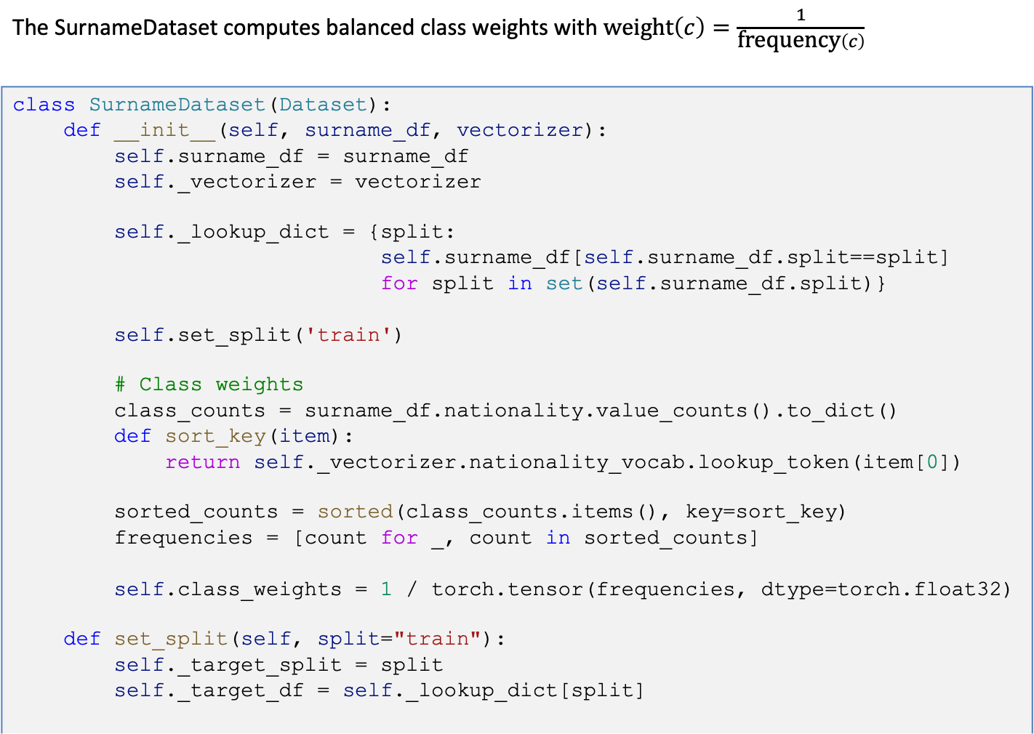
DataSet
The SurnameDataset computes balanced class weights with $\text{weight}\left(c\right)=\frac{1}{\text{frequency}\left(c\right)}$
class SurnameDataset(Dataset): def __init__(self, surname_df, vectorizer): self.surname_df = surname_df self._vectorizer = vectorizer self._lookup_dict = {split: self.surname_df[self.surname_df.split==split] for split in set(self.surname_df.split)} self.set_split('train') # Class weights class_counts = surname_df.nationality.value_counts().to_dict() def sort_key(item): return self._vectorizer.nationality_vocab.lookup_token(item[0]) sorted_counts = sorted(class_counts.items(), key=sort_key) frequencies = [count for _, count in sorted_counts] self.class_weights = 1 / torch.tensor(frequencies, dtype=torch.float32) def set_split(self, split="train"): self._target_split = split self._target_df = self._lookup_dict[split]

Slide 11
DataSet
The Dataset class is an abstract iterator. Subclassing (or inheriting from) the Dataset class requires implementation of __getitem__() and __len__() methods.
def __len__(self): return len(self._target_df) def __getitem__(self, index): row = self._target_df.iloc[index] surname_vector = self._vectorizer.vectorize(row.surname) nationality_index = self._vectorizer.rating_vocab.lookup_token(row.nationality) return {'x_surname': surname_vector, 'y_nationality': nationality_index} def get_num_batches(self, batch_size): return len(self) // batch_size @classmethod def load_dataset_and_make_vectorizer(cls, surname_csv): surname_df = pd.read_csv(surname_csv) train_df = surname_df[surname_df.split=='train'] vectorizer = SurnameVectorizer.from_dataframe(train_df) return cls(surname_df, vectorizer)

Slide 12
DataLoader
DataLoader is used for grouping the vectorized datapoints. It coordinates the process of grouping into minibatches.
from torch.utils import DataLoader def generate_batches(dataset, batch_size, shuffle=True, drop_last=True, device="cpu"): dataloader = DataLoader(dataset=dataset, batch_size=batch_size, shuffle=shuffle, drop_last=drop_last) for data_dict in dataloader: out_data_dict = {} for name, tensor in data_dict.items(): out_data_dict[name] = data_dict[name].to(device) yield out_data_dict

Slide 13
A Multilayer Perceptron Classifier
SurnameClassifier is an implementation of MLP. The first Linear layer maps the input vectors to an intermediate vector, and a nonlinearity is applied to that vector. A second Linear layer maps the intermediate vector to the prediction vector. In the last step, the softmax function is optionally applied to make sure the outputs sum to 1; that is, are interpreted as "probabilities."
class SurnameClassifier(nn.Module): def __init__(self, input_dim, hidden_dim, output_dim): super(SurnameClassifier, self).__init__() self.fc1 = nn.Linear(input_dim, hidden_dim) self.fc2 = nn.Linear(hidden_dim, output_dim) def forward(self, x_in, apply_softmax=False): intermediate_vector = F.relu(self.fc1(x_in)) prediction_vector = self.fc2(intermediate_vector) if apply_softmax: prediction_vector = F.softmax(prediction_vector, dim=1) return prediction_vector

Slide 14
The Training Routine
Train state is meant to keep early stopping parameters, learning rate, training, validation and evaluation losses training, validation and evaluation accuracies
def make_train_state(args): return {'stop_early': False, 'early_stopping_step': 0, 'early_stopping_best_val': 1e8, 'learning_rate': args.learning_rate, 'epoch_index': 0, 'train_loss': [], 'train_acc': [], 'val_loss': [], 'val_acc': [], 'test_loss': -1, 'test_acc': -1, 'model_filename': args.model_state_file}

Slide 15
The Training Routine
Method update_train_state() uses current training state to decide if early stopping is needed. Training should be stopped at the point when performance on a validation dataset starts to degrade. This simple, effective, and widely used approach to training neural networks is called early stopping.
def update_train_state(args, model, train_state): # Save one model at least if train_state['epoch_index'] == 0: torch.save(model.state_dict(), train_state['model_filename']) train_state['stop_early'] = False # Save model if performance improved elif train_state['epoch_index'] >= 1: loss_tm1, loss_t = train_state['val_loss'][-2:] # If loss worsened if loss_t >= train_state['early_stopping_best_val']: # Update step train_state['early_stopping_step'] += 1 # Loss decreased else: # Save the best model torch.save(model.state_dict(), train_state['model_filename']) # Reset early stopping step train_state['early_stopping_step'] = 0 # Stop early ? train_state['stop_early'] = (train_state['early_stopping_step'] >= args.early_stopping_criteria) return train_state

Slide 16
The Training Routine
Arguments of the training routine contains: filenames of dataset, vectorizers and models, model hyper parameters, training parameters.
args = Namespace( # Data and path information surname_csv="surnames_with_splits.csv", vectorizer_file="vectorizer.json", model_state_file="model.pth", save_dir=".", # Model hyper parameters hidden_dim=300, # Training hyper parameters seed=1337, num_epochs=100, early_stopping_criteria=5, learning_rate=0.001, batch_size=64, # Runtime options cuda=False, reload_from_files=False, expand_filepaths_to_save_dir=True, ) # Check CUDA if not torch.cuda.is_available(): args.cuda = False args.device = torch.device("cuda" if args.cuda else "cpu")

Slide 17
The Training Routine
Initialization of training routine: loads the dataset gets the vectorizer instantiate the model, define the loss function, optimizer and learning rate scheduler create initial train state
dataset = SurnameDataset.load_dataset_and_make_vectorizer(args.surname_csv) vectorizer = dataset.get_vectorizer() classifier = SurnameClassifier(input_dim=len(vectorizer.surname_vocab), hidden_dim=args.hidden_dim, output_dim=len(vectorizer.nationality_vocab)) classifier = classifier.to(args.device) dataset.class_weights = dataset.class_weights.to(args.device) loss_func = nn.CrossEntropyLoss(dataset.class_weights) optimizer = optim.Adam(classifier.parameters(), lr=args.learning_rate) scheduler = optim.lr_scheduler.ReduceLROnPlateau(optimizer=optimizer, mode='min', factor=0.5, patience=1) train_state = make_train_state(args)

Slide 18
The Training Routine
Setting progress bars for epoch, training and validation.
epoch_bar = tqdm(desc='training routine', total=args.num_epochs, position=0) dataset.set_split('train') train_bar = tqdm(desc='split=train', total=dataset.get_num_batches(args.batch_size), position=1, leave=True) dataset.set_split('val') val_bar = tqdm(desc='split=val', total=dataset.get_num_batches(args.batch_size), position=1, leave=True)

Slide 19
The Training Routine
Train Split zero the gradients compute the output compute the loss (moving average) use loss to produce gradients use optimizer to take gradient step compute the accuracy update the bar
for epoch_index in range(args.num_epochs): train_state['epoch_index'] = epoch_index dataset.set_split('train') batch_generator = generate_batches(dataset, batch_size=args.batch_size, device=args.device) running_loss = 0.0 running_acc = 0.0 classifier.train(True) for batch_index, batch_dict in enumerate(batch_generator): optimizer.zero_grad() # (1) y_pred = classifier(batch_dict['x_surname']) # (2) # (3) loss = loss_func(y_pred, batch_dict['y_nationality']) loss_t = loss.item() running_loss += (loss_t - running_loss) / (batch_index + 1) loss.backward() # (4) optimizer.step() # (5) # (6) acc_t = compute_accuracy(y_pred, batch_dict['y_nationality']) running_acc += (acc_t - running_acc) / (batch_index + 1) # (7) train_bar.set_postfix(loss=running_loss, acc=running_acc, epoch=epoch_index + 1) train_bar.update() train_state['train_loss'].append(running_loss) train_state['train_acc'].append(running_acc)

Slide 20
The Training Routine
Val Split compute the output compute the loss (moving average) compute the accuracy update the train state update the learning rate of the optimizer according to the loss after validation checks for the early stopping update bars
dataset.set_split('val') batch_generator = generate_batches(dataset, batch_size=args.batch_size, device=args.device) running_loss = 0. running_acc = 0. classifier.train(False) # equivalent to classifier.eval() for batch_index, batch_dict in enumerate(batch_generator): y_pred = classifier(batch_dict['x_surname']) # (1) # (2) loss = loss_func(y_pred, batch_dict['y_nationality']) loss_t = loss.to("cpu").item() running_loss += (loss_t - running_loss) / (batch_index + 1) # (3) acc_t = compute_accuracy(y_pred, batch_dict['y_nationality']) running_acc += (acc_t - running_acc) / (batch_index + 1) val_bar.set_postfix(loss=running_loss, acc=running_acc, epoch=epoch_index) val_bar.update() train_state['val_loss'].append(running_loss) train_state['val_acc'].append(running_acc) train_state = update_train_state(args=args, model=classifier, train_state=train_state) # (4) scheduler.step(train_state['val_loss'][-1]) # (5) if train_state['stop_early']: # (6) break # (7) train_bar.n = 0 val_bar.n = 0 epoch_bar.update()

Slide 21
Evaluation
Test Split compute the output compute the loss (moving average) compute the accuracy
# compute the loss & accuracy on the test set using the best available model classifier.load_state_dict(torch.load(train_state['model_filename'])) classifier = classifier.to(args.device) dataset.class_weights = dataset.class_weights.to(args.device) loss_func = nn.CrossEntropyLoss(dataset.class_weights) dataset.set_split('test') batch_generator = generate_batches(dataset, batch_size=args.batch_size, device=args.device) running_loss = 0. running_acc = 0. classifier.eval() for batch_index, batch_dict in enumerate(batch_generator): y_pred = classifier(batch_dict['x_surname']) # (1) # (2) loss = loss_func(y_pred, batch_dict['y_nationality']) loss_t = loss.item() running_loss += (loss_t - running_loss) / (batch_index + 1) # (3) acc_t = compute_accuracy(y_pred, batch_dict['y_nationality']) running_acc += (acc_t - running_acc) / (batch_index + 1) train_state['test_loss'] = running_loss train_state['test_acc'] = running_acc print(f"Test loss: {train_state['test_loss']}") print(f"Test Accuracy: {train_state['test_acc']}")
Test loss: 1.7831669425964354 Test Accuracy: 46.31249999999999

Slide 22
Evaluation
Plot confusion matrix
dataset.set_split("test") data = next(generate_batches(dataset, len(dataset))) x_data, y_truth = data["x_surname"], data["y_nationality"] y_pred = classifier(x_data, apply_softmax=True).argmax(dim=1) labels = list(vectorizer.nationality_vocab._token_to_idx) conf_df = pd.DataFrame(confusion_matrix(y_truth, y_pred), index=labels, columns=labels) sns.heatmap(conf_df, annot=True, cbar=None, cmap="YlGnBu", fmt="d") plt.tight_layout() plt.ylabel("True Class"), plt.xlabel("Predicted Class") plt.show()

Slide 23
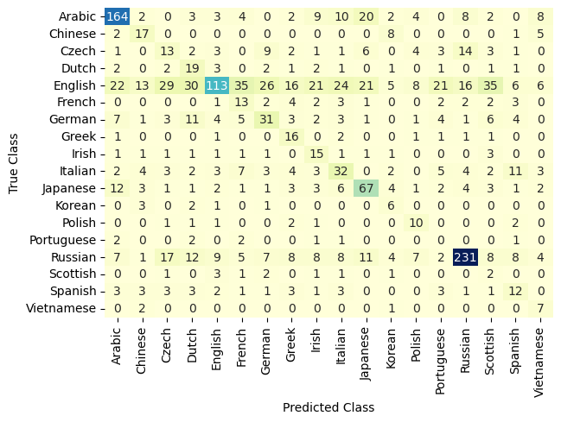
Evaluation

Slide 24
Inference
Another method for evaluating the model is to do inference on new data and make qualitative judgments about whether the model is working. Given a surname as a string, the function will first apply the vectorization process and then get the model prediction. Notice that we include the apply_softmax flag so that result contains probabilities. The model prediction, in the multinomial case, is the list of class probabilities. PyTorch tensor max() function gets the best class, represented by the highest predicted probability.
def predict_nationality(surname, classifier, vectorizer): vectorized_surname = vectorizer.vectorize(surname) vectorized_surname = torch.tensor(vectorized_surname).view(1, -1) result = classifier(vectorized_surname, apply_softmax=True) probability_values, indices = result.max(dim=1) index = indices.item() predicted_nationality = vectorizer.nationality_vocab.lookup_index(index) probability_value = probability_values.item() return {'nationality': predicted_nationality, 'probability': probability_value}

Slide 25
Inspection
It is often useful to look at more than just the best prediction. For example, it is standard practice in NLP to take the top k best predictions and rerank them using another model. PyTorch provides a torch.topk() function that offers provides a convenient way to get these predictions.
def predict_topk_nationality(name, classifier, vectorizer, k=5): vectorized_name = vectorizer.vectorize(name) vectorized_name = torch.tensor(vectorized_name).view(1, -1) prediction_vector = classifier(vectorized_name, apply_softmax=True) probability_values, indices = torch.topk(prediction_vector, k=k) # returned size is 1,k probability_values = probability_values.detach().numpy()[0] indices = indices.detach().numpy()[0] results = [] for prob_value, index in zip(probability_values, indices): nationality = vectorizer.nationality_vocab.lookup_index(index) results.append({'nationality': nationality, 'probability': prob_value}) return results def run_topk_predictions(surname, k=5): if k > len(vectorizer.nationality_vocab): print("Sorry! That's more than the # of nationalities we have.. / defaulting you to max size :)") k = len(vectorizer.nationality_vocab) predictions = predict_topk_nationality(surname, classifier, vectorizer, k=k) print(f"Top {k} predictions:") print("===================") for prediction in predictions: print(f"{surname} -> {prediction['nationality']} / (p={prediction['probability']:0.2f})")

Slide 26
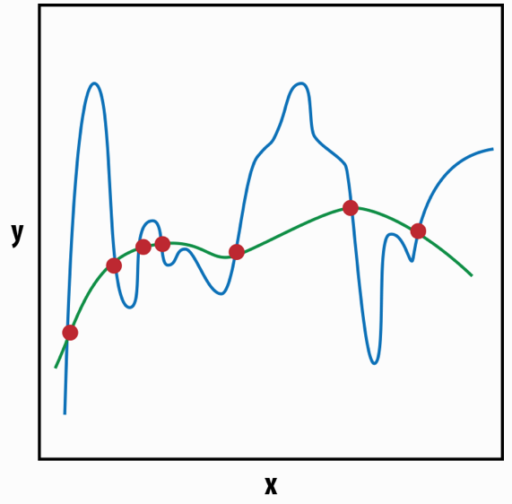
Weight Regularization and Structural Regularization
The concept of regularization comes from numerical optimization theory.
Recall that most machine learning algorithms are optimizing the loss function to find the most likely values of the parameters (or "the model") that explains the observations (i.e., produces the least amount of loss).
Both curves "fit" the points, but one of them seems more reasonable than the other—regularization helps us to select this more reasonable explanation.

Slide 27
Weight Regularization and Structural Regularization
In PyTorch, you can control weight regularization by setting the weight_decay parameter in the optimizer. The larger the weight_decay value, the more likely it is that the optimizer will select the smoother explanation (that is, the stronger is the L2 regularization). In addition to L2, another popular regularization is L1 regularization. L1 is usually used to encourage sparser solutions; in other words, where most of the model parameter values are close to zero.
optimizer = optim.Adam(classifier.parameters(), lr=args.learning_rate, weight_decay=1e-5)

Slide 28
Weight Regularization and Structural Regularization
In addition to weight regularization, for deep models (i.e., models with multiple layers) such as the feed-forward networks discussed in this chapter, a structural regularization approach called dropout becomes very important. Dropout probabilistically drops connections between units belonging to two adjacent layers during training. Dropout does not add additional parameters to the model, but requires a single hyperparameter—the "drop probability". This is the probability with which the connections between units are dropped. It is typical to set the drop probability to 0.5.
class SurnameClassifier(nn.Module): def __init__(self, input_dim, hidden_dim, output_dim): super(SurnameClassifier, self).__init__() self.fc1 = nn.Linear(input_dim, hidden_dim) self.fc2 = nn.Linear(hidden_dim, output_dim) def forward(self, x_in, apply_softmax=False): intermediate_vector = F.relu(self.fc1(x_in)) prediction_vector = self.fc2(F.dropout(intermediate_vector, p=0.5)) if apply_softmax: prediction_vector = F.softmax(prediction_vector, dim=1) return prediction_vector
It is important to note that dropout is applied only during training and not during evaluation.

